Slide 1
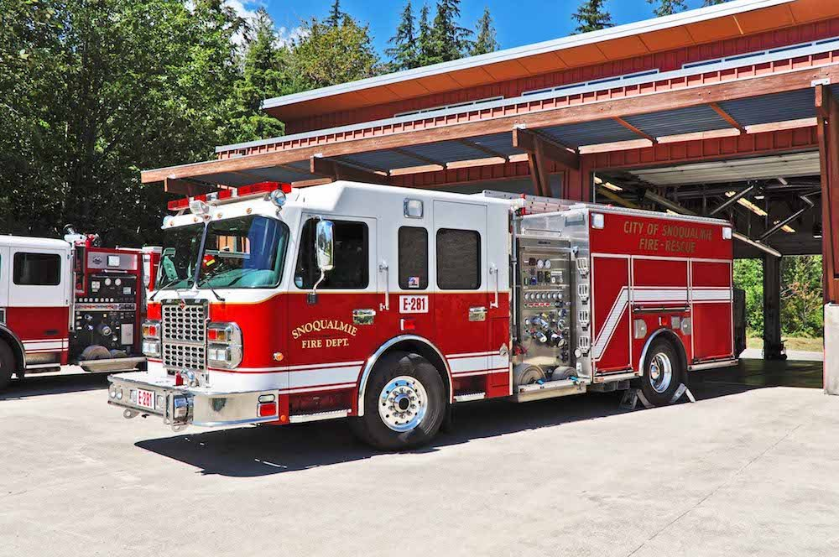
Fire Prevention Month
Snoqualmie Fire Department

Slide 2
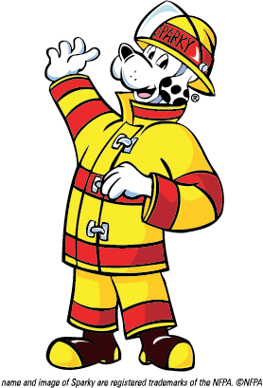
Fire safety Video with sparky!

Slide 3
What number do you call if there is an emergency???
911
What is an emergency?

Slide 4
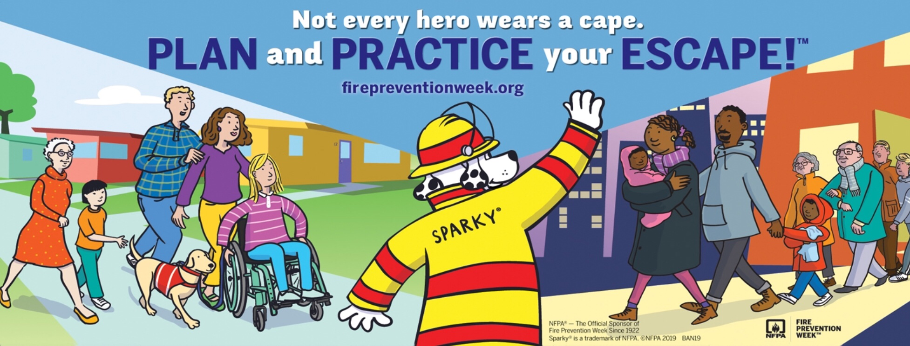

Slide 5
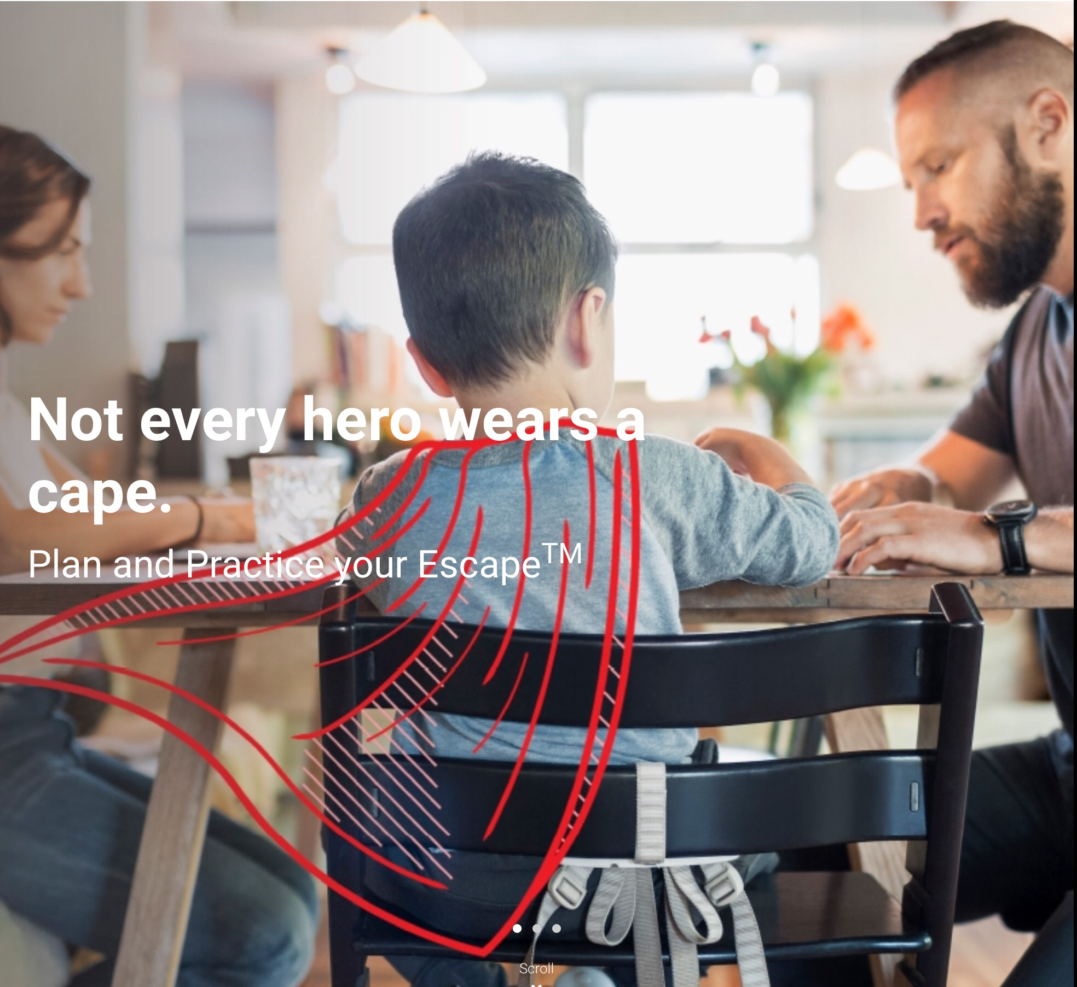

https://youtu.be/4I1nb9VD-mk
Does your family have a home escape plan???

Slide 6
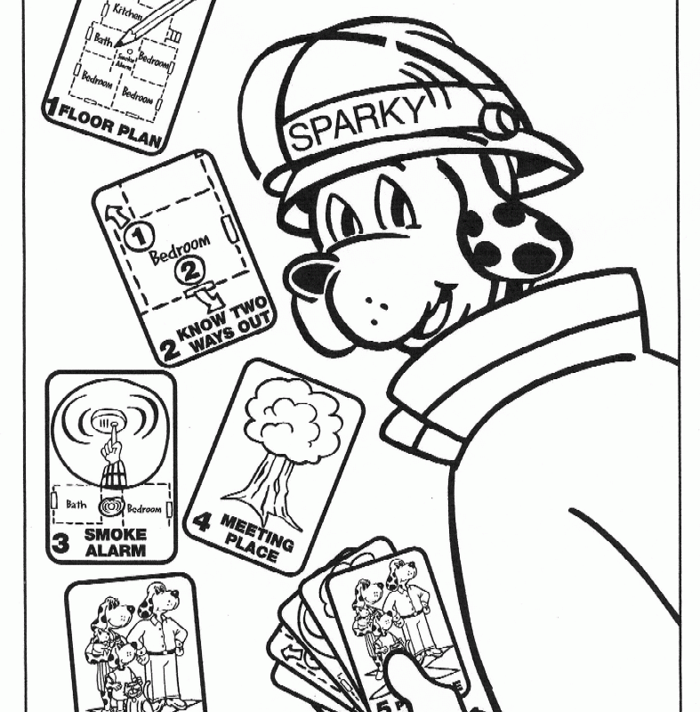
Listen for the smoke alarm. Go to your meeting place.
What is a meeting place?
  Place where everyone in your family goes once they get out of the house
Why is it important?
  If someone is missing, you can tell the firefighters, and they will look for them.
Are you supposed to leave your meeting place?
  Never leave your meeting place!

Slide 7


Do you have a meeting place??

Slide 8
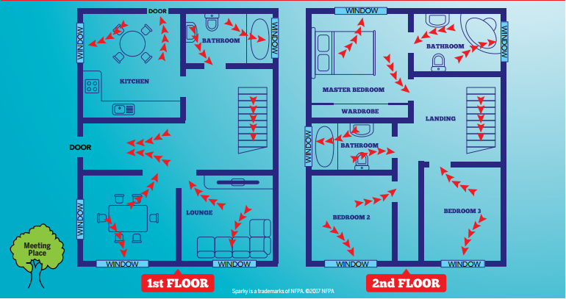
Learn two ways out of every room (video)
Work with your family to find 2 ways out of every room!
https://youtu.be/Q1N8e8zk-8E

Slide 9
What is an escape plan?
  Two ways out from each room in your home
How can you exit your house?
  Doors and windows
Where do you go?
  Your meeting place!

Slide 10
Do I get dressed before I leave my room?
NO!!!!
What about my favorite blanket?
NO!!!!
Favorite toys or video games?
NO!!!!

Slide 11

What about my homework???

Slide 12
The most important thing to do if there is a fire is to get out & stay out!
  Use your senses to:
    Listen for the smoke alarm
    Smell for smoke
    Touch doors for heat
    Look for a safe exit – Stay low and go!
Everything else can be replaced, but you are one of a kind and irreplaceable!!!!

